Slide 1
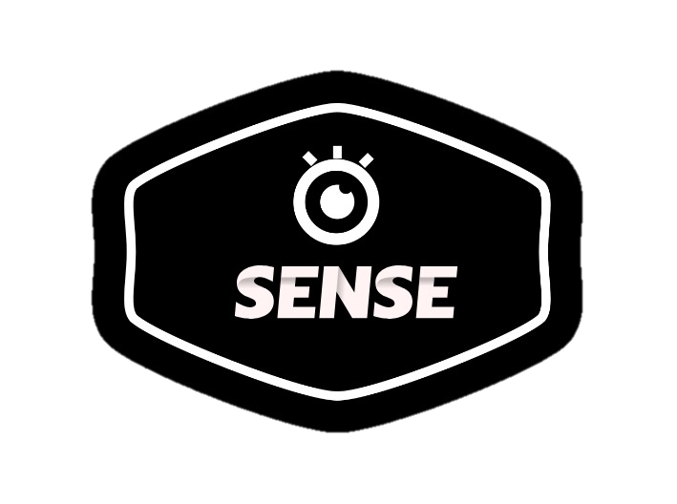

System for Environment Navigation using Snapshots and Exploration

Slide 2
OBJECTIVE
Dire need for visually impaired people to navigate their life more easily.
Need for information regarding objects around them with which they can interact.
Need for a fast and efficient object detection/recognition for the purpose.

Slide 3
SOLUTION
Use YOLO library and CNNs for fast and accurate object detection and recognition.
Integrate with wearable devices to capture surroundings and provide audio feedback.
Create a user-friendly interface with voice commands and tactile inputs.
Provide real-time alerts for obstacles and hazards.
Implement continuous learning for improved object recognition over time.

Slide 4



USE CASES
Outdoor Navigation: Navigate streets and parks with real-time obstacle alerts.
Indoor Wayfinding: Identify elevators and entrances for seamless indoor navigation.
Grocery Shopping: Locate items on shelves independently while shopping.
Public Transportation: Access bus numbers and train platforms for easy commuting.
Social Interactions: Recognize faces and expressions for improved social interactions.
TECHNOLOGY STACK
Python
YOLO (You only look Once)
Open CV
Convolution neural network (CNN)

Slide 5
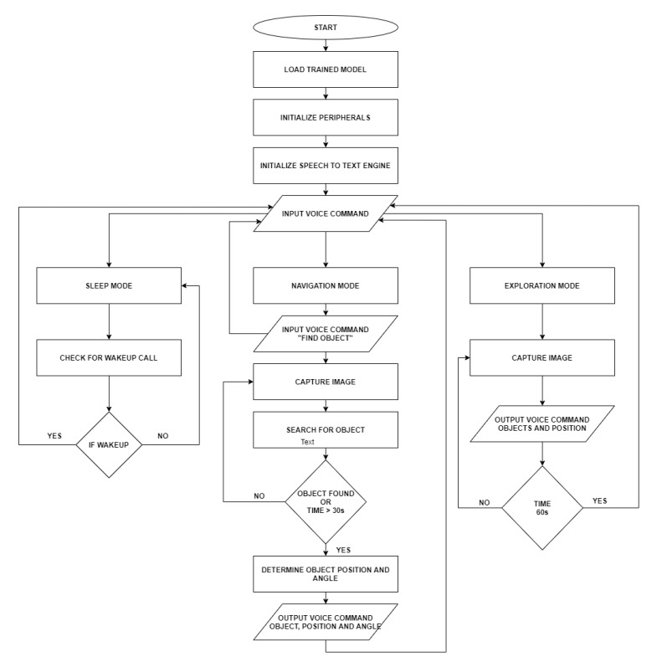
FLOWCHART

Slide 6
Challenges:
Performance Trade-offs: Balancing speed and accuracy with YOLO and CNNs for object detection can be challenging.
Hardware Limitations: Integrating with wearable devices may face constraints in processing power and battery life.
User Interface Complexity: Designing an intuitive interface with voice and tactile inputs requires careful consideration and testing.
Real-Time Responsiveness: Ensuring timely alerts for obstacles may be hindered by latency and processing constraints

Slide 7
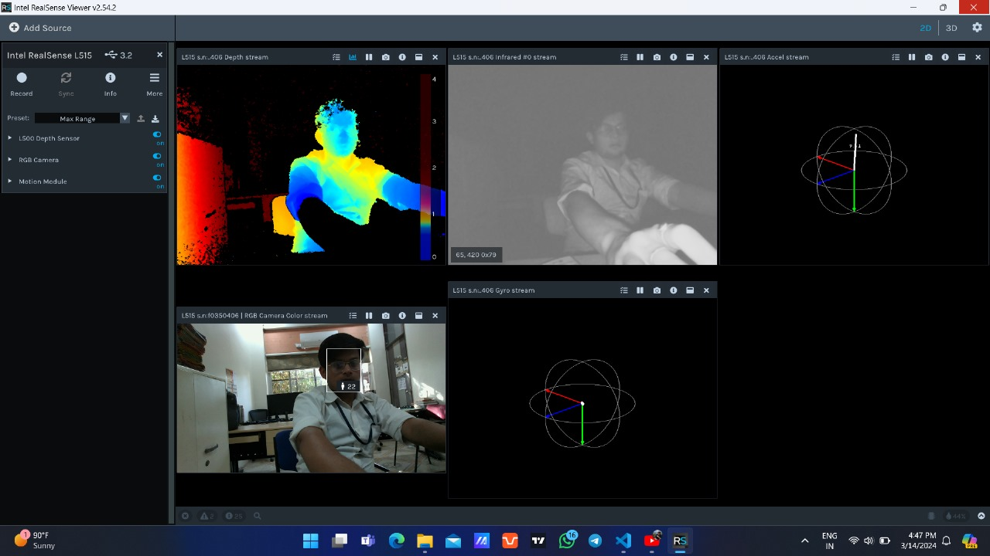
SNAPSHOTS

Slide 8
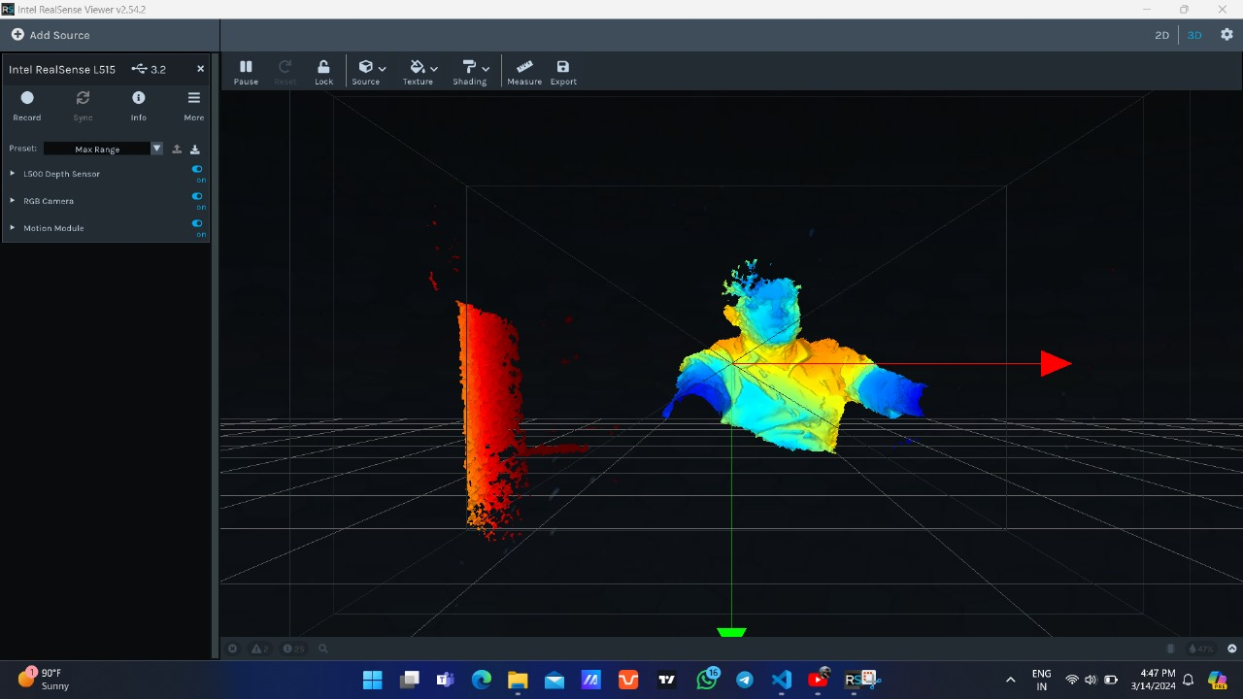
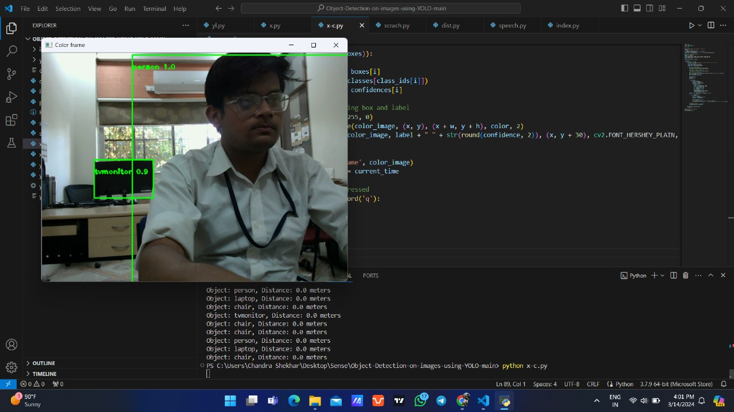

Slide 9
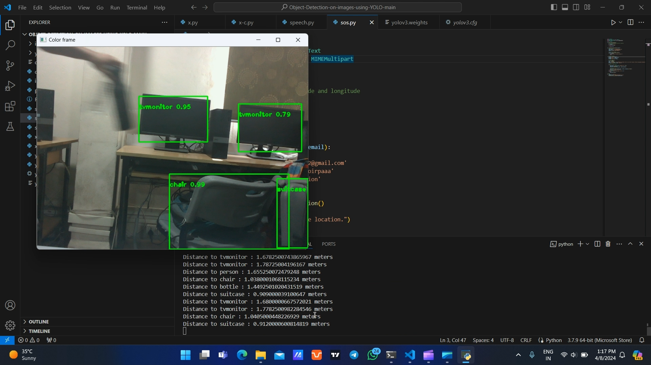
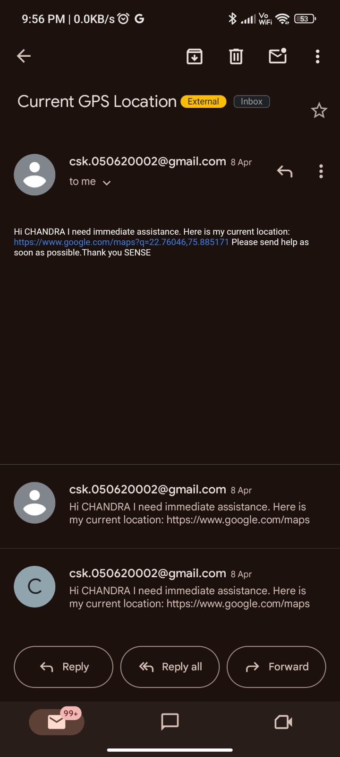
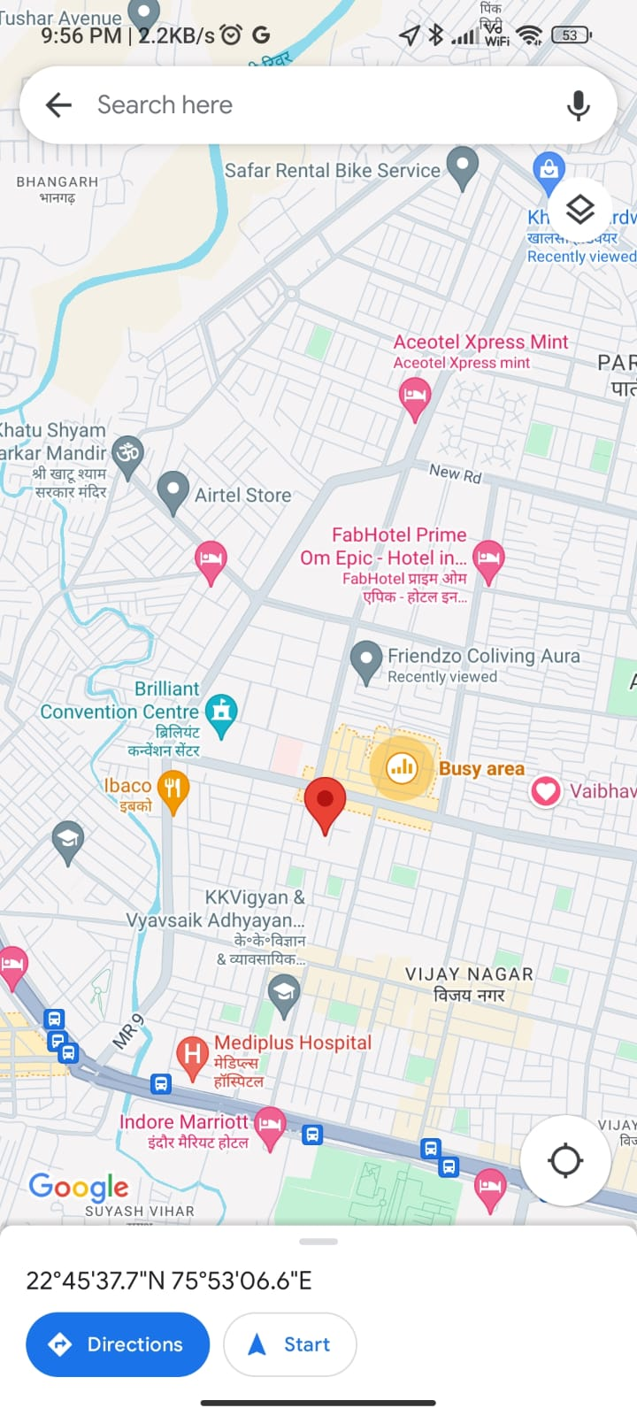

Slide 10
FUTURE SCOPE
Enhancing speed and precision through advanced algorithms.
Integrating sensors for dynamic functionality.
Developing specialized models for targeted tasks.
Utilizing NVIDIA Jetson for high-performance computing.

Slide 11
References:
Specht, Donald F. "A general regression neural network." IEEE transactions on neural
networks 2, no. 6 (1991): 568-576.
Simard, Patrice Y., David Steinkraus, and John C. Platt. "Best practices for convolutional
neural networks applied to visual document analysis." In Icdar, vol. 3, no. 2003. 2003.
Duy Thanh Nguyen, Tuan Nghia Nguyen, Hyun Kim and Hyuk-Jae Lee “IEEE
TRANSACTION ON VERY LARGE-SCALE INTEGRATION (VLSI) SYSTEMS-A High
Throughput and PowerEfficient FPGA Implementation of YOLO CNN of Object Detection.”
Martin Simony, Stefan Milzy, Karl Amendy, Horst-Micheal Gross “Complex-YOLO:An
Euler-Region-Proposal for Real-time 3D Object Detection on Point Clouds”

Slide 12
TEAM MEMBERS
MENTOR
Mohammad Bilal Khan Branch : CSE
Ruchita Rani Branch : CSE
Chandra Shekhar Kushwaha Branch : AIDS
Avni Verma Branch : AIDS
Dr. Naveen R Shahi

